Slide 1
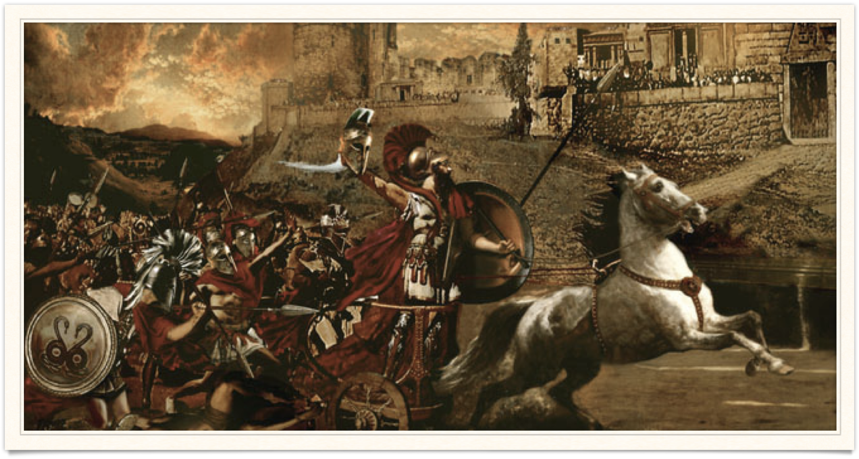
Evidence & Myth
Goal/s:
Analyse evidence of the trojan war
Create arguments – myth or fact?
Week 5 Lesson 3
Ms Barrie

Slide 2

For the Greeks and beyond, the Trojan War was a favourite narrative of great men and their deeds. It was also a popular subject for Ancient artists and playwrights. The Trojan War provided powerful inspiration for both personal values and national identity. Greek youths were raised in the traditions of Homer. An important part of their education was learning to recite long passages of Homer by heart. Greek soldiers marched into battle to emulate the great deeds of warrior heroes such as Achilles and Hektor.

Slide 3
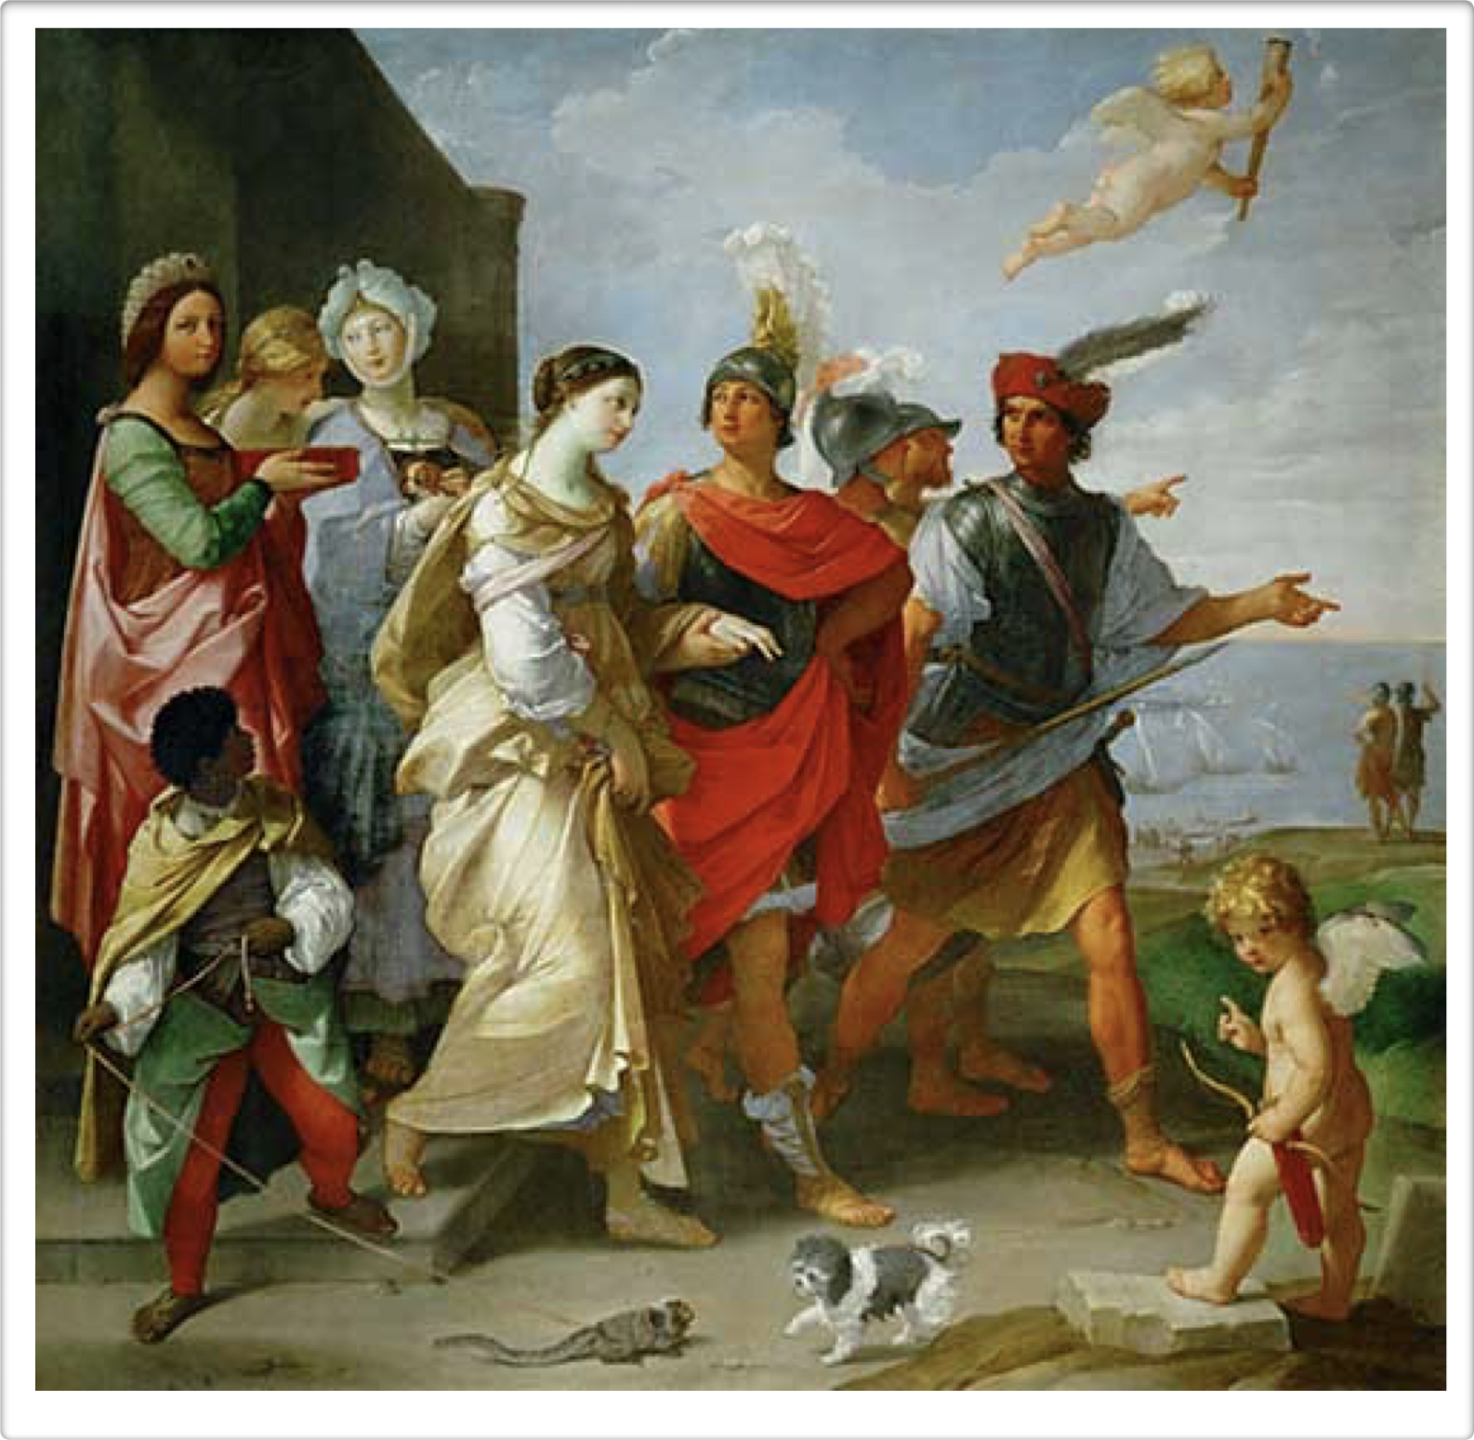
Guido Reni Abduction of Helen

Slide 4
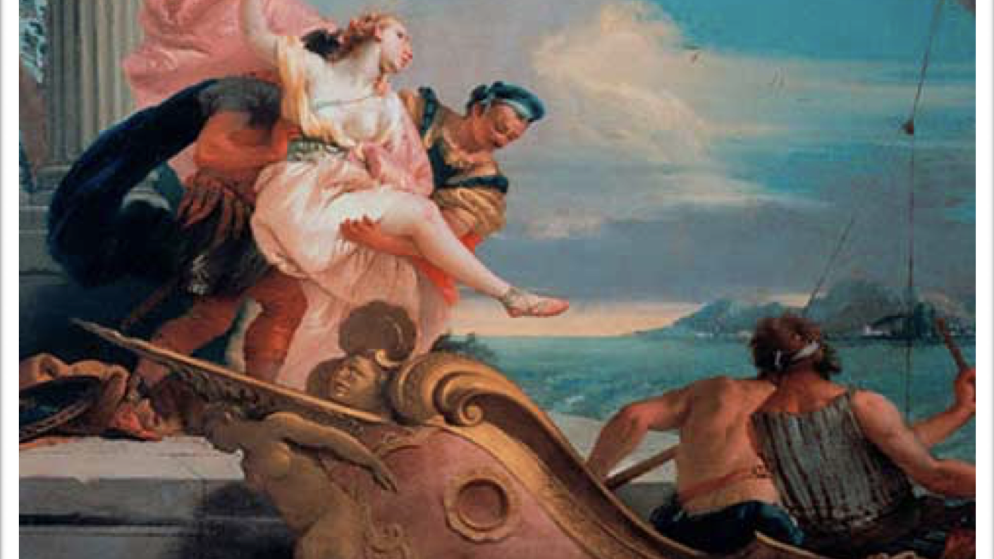
Jahrhundert Abduction of Helen

Slide 5
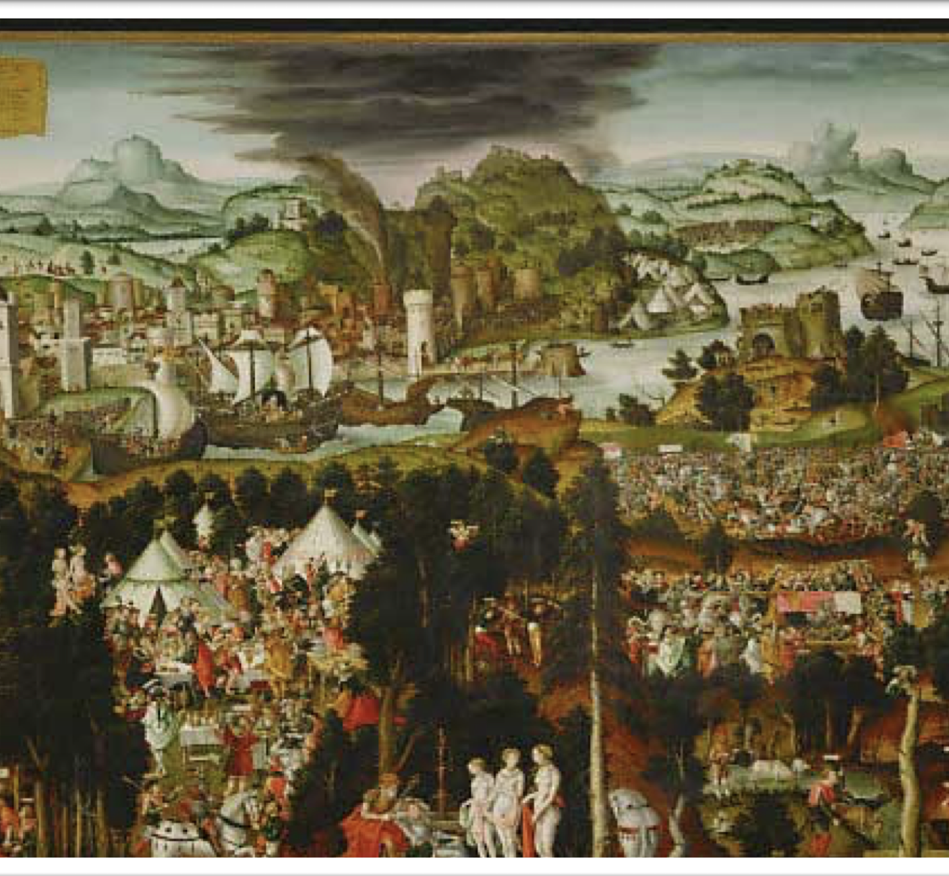
Gerung Matthias Destruction of Troy

Slide 6
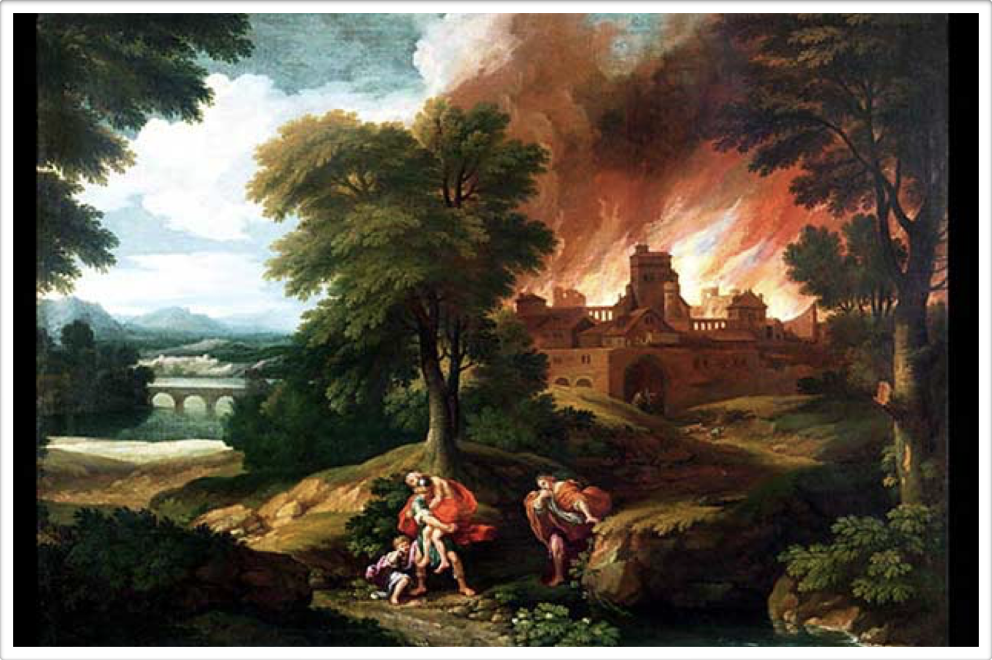
Nicolas Poussin Burning of Troy

Slide 7
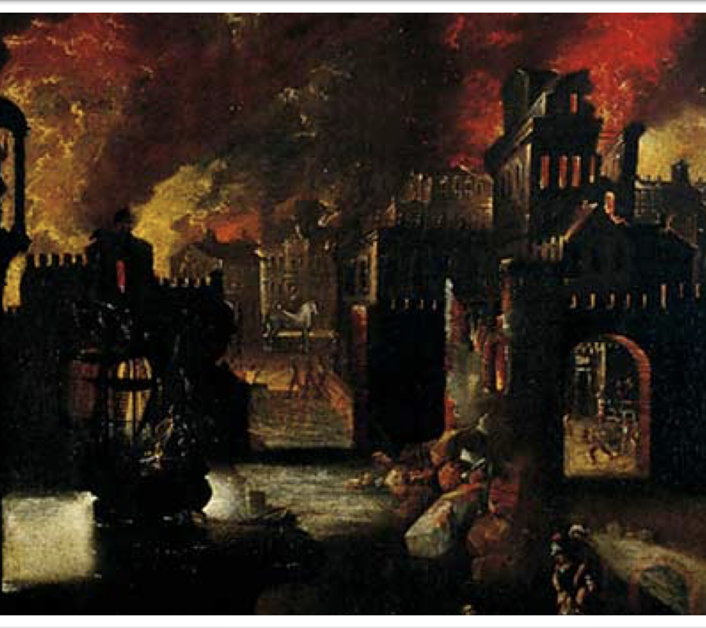
Diogo Pereira Burning of Troy

Slide 8
Legacy/Impacts
Important part of cultural heritage
Inspired modern artists and media (tv/movies)
The stories mean different things to different people
Different interpretations:
as heroic tragedy, military history, romantic love story, or an anti-war tale

Slide 9
Several modern terms and expressions can be traced to the Trojan War.
Achilles Tendon
Calling something an ‘Achilles heel’
Trojan horse Computer Virus
The face that launched a thousand ships
Snow White
___________________________________________________________________________
Hollywood has had a long love affair with the ancient world. The genre of films inspired by the series and people of the biblical and ancient world are called ‘Sword and Sandal’ epics.
Some of the best known and most successful of these films were made in the 50s and 60s.
Notes:
What movies do you know of?

Slide 10
Class Discussion
What were the causes of the trojan war?

Slide 11
Class Discussion
Is it true or is it a myth?

Slide 12
Main sources of evidence
Main source is Homer’s Iliad (written)
Archaeological discoveries
Remains of archives from Mycenaeans (linear B), and the Hittites

Slide 13
Homer’s Illiad
Main written source of story - Homer’s Iliad
Little is known about the historical Homer.
Historians date the completion of the “Iliad” to about 750 B.C.,
The “Odyssey” to about 725.
Both began within the oral tradition, and were first transcribed decades or centuries after their composition.
Many of the most familiar episodes of the war, from the abduction of Helen to the Trojan Horse and the sack of Troy, come from the so-called “Epic Cycle” of narratives assembled in the sixth century B.C. from older oral traditions.
No real date given but approx 1275 -1200 BCE

Slide 14
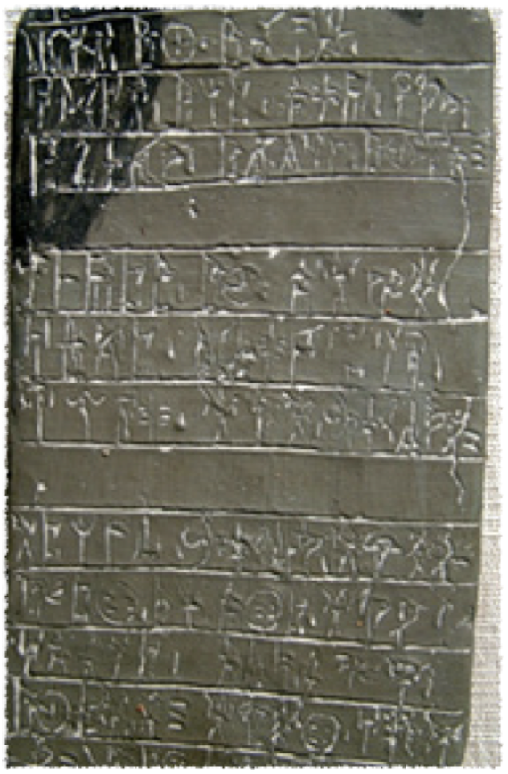
Linear A Tablet
Inscribed on clay
PYLOS ARCHIVE insight into Trojan War
Give clues relating to the Trojan War
Reference to a large group of slave women and children - assumed to be foreigners from different places who had been captured by Mycenaeans
Also reference to catalogue of ships Mycenaeans would have used to sail to troy
NO recognisable reference to Troy or characters in Homer’s Iliad

Slide 15
Hittite archive
Hittites = warlike and powerful civilisation that existed at the same time as the Mycenaeans
Script on clay tablets - CUNEIFORM
Describe conflict between the Hittites and Ahhiyawa (name for Mycenaeans)
Troy is an important regional centre, located at the edge of the Hittite Empire, it seemed likely that there would be references to Troy in the Hittite archives.
Wilusa, referred to in the Hittite tablets as the name of a kingdom in western Anatolia, was the ancient Anatolian name for Troy. However, the tablets themselves give no clear indication of where Wilusa was situated geographically
Conclusion that there is only one possible location for Wilusa - in the far Northwest corner of Turkey, the precise location of the site of Troy. It seems likely that Wilusa and Troy are one and the same.
Texts also make reference to the land of Ahhiyawa: associated with boats, islands and phrases like “across the sea”.
Scholars have therefore suggested that Ahhiyawa is the Hittite name for Mycenaean Greece.

Slide 16
Activity 1 – ‘To Troy and Back’
Get ONE (1) information sheet between two
WHAT AM I LOOKING FOR?
Highlight key words in the text
Answer the following questions in your book:
Who are the following people: Penelope, Thetis, Hektor, Achilles
Who is ‘Heinrich Schliemann’ and how does he relate to this myth?
What was the significance of the Trojan Horse?
Describe the ‘blinding of polyphemus’

